Slide 1
NETW211 Course Project Module 5 Cloud Storage

Slide 2
Rubric
Activity | Requirement(s) | Points
Uploading and Accessing a File | Screenshot | 15
Creating Blob Snapshots | Question, Screenshot | 30
Enabling Blob Versioning | Screenshot | 15

Slide 3
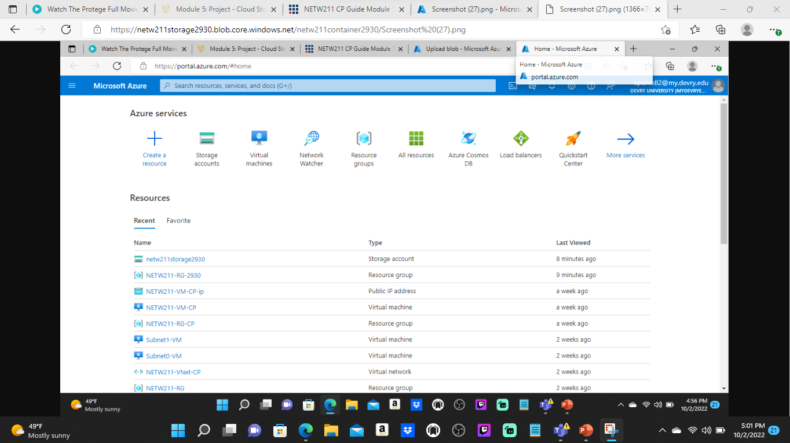
Uploading and Accessing a File
This screenshot should show the browser window with the image uploaded from your local computer and the URL on top of the window.

Slide 4
Question
What does the access tier setting do? What are the Azure blob storage access tiers?
[hint: in the Azure portal, on the Upload blob page, under Advanced, click the ? circle above the Access tier box.]
Answer here:
Indicates the online tier in which a new blob is created.
Online access tiers When your data is stored in an online access tier.
Blob lifecycle management.
References (here are two examples to get your research started):
1. Hot, Cool, and Archive access tiers for blob data, https://docs.microsoft.com/en-us/azure/storage/blobs/access-tiers-overview
2. Azure Blob Storage Access Tiers, https://devry.percipio.com/courses/c7ef0333-8560-403f-a004-9c5c843866b0/videos/2658bbe6-ee97-438b-a376-fbb079c3b3a0
3.
4.

Slide 5
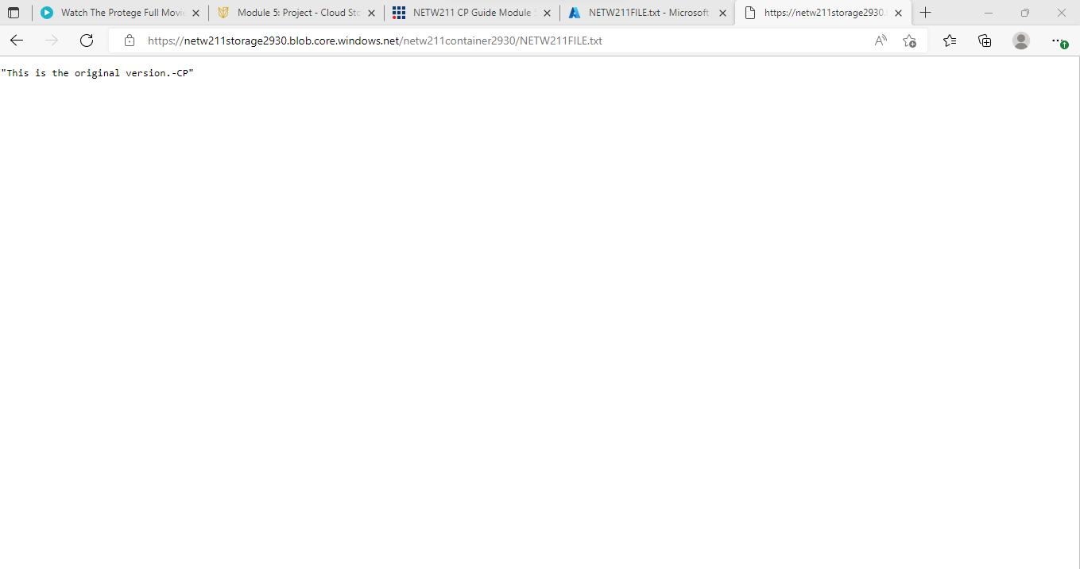
Creating Blob Snapshots
This screenshot should show the browser window with the “This is the original version. –Your Initials” message and the URL on top of the window

Slide 6
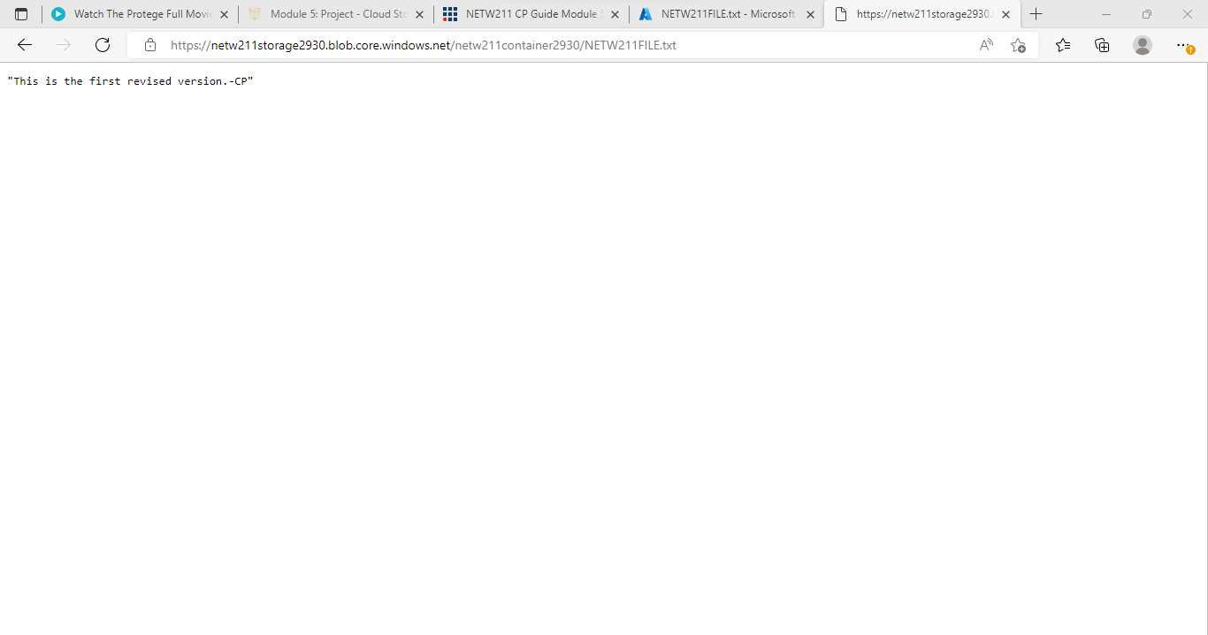
Enabling Blob Versioning
This screenshot should show the browser window with the “This is the first revised version. –Your Initials” message and the URL on top of the window.

